Slide 1
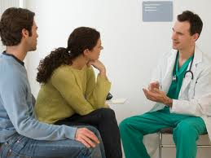
The Health Care System and You
Notes:
Emphasize that this is representative of the community

Slide 2
Introduction
Who we are
Why we are here
What we are going to talk about in this workshop
Why should this matter to you
This will be interactive

Slide 3
QUIZ
1. You are allowed to bring a friend/ partner to a doctor’s appointment
True or False?
2. You should always go to the emergency room for Diarrhea
True or False?
3. Once you have a family doctor, you are not allowed to change doctors
True or False?

Slide 4
Topics Today
Finding a Doctor
Making an Appointment and Preparing for it
Your Rights As a Patient
Getting the Most out of Your Dr Appointment
Common Symptoms
When to go to Emergency Room
How to Read a Prescription Bottle

Slide 5
Finding a Regular Doctor
BC College of Physicians and Surgeons - resource
Ask friends, neighbors and co-workers
Visit the Yellow Pages in the phone book or on the internet, look under "Physicians and Surgeons”
Hospitals have lists of Drs accepting new patients
Make a list of candidate doctors
Notes:
Ask friends, neighbors and co-workers if their doctor is accepting new patients (and if they like their doctor)
*Asks the participants what value they see in having a regular doctor compared to walk-in clinics.
*Asks for questions at this point
Visit the Yellow Pages in the phone book or on the internet (computers at public libraries are free and accessible to everyone) and look for doctors under "Physicians and Surgeons”
Clinic for refugees and immigrants (with and without legal status) – Bridge Community Health Clinic at Raven Song Community Health Centre, Ontario and 8th St, (604) 709-6540

Slide 6
Making an Appointment in the Community
Explain to the receptionist that you are looking for a new doctor, and would like to meet with the doctor
If possible, don’t plan to discuss a problem at this visit
Use this opportunity to get to know the doctor
This is a chance for the doctor to find out about you and your health.
Notes:
When you book your appointment, explain to the receptionist that you are looking for a new doctor, and you would like to meet with the doctor to get to know him or her. If possible, don’t plan to discuss a problem at this visit (don’t wait until you are very sick to meet your potential new doctor)
The receptionist is very important – she is the gatekeeper. Always be nice. When you go to an appointment, you have to sign in with the receptionist and let her know you’re there.
*This is an opportunity for you to see how comfortable you are with the doctor.
Your doctor can only help you if you communicate openly.
*Change heading to Making an Appointment in the Community.

Slide 7
Community Clinic
Non-profit organization set up to serve a particular community
E.g. Inner city community clinics are specialized in addiction and mental health
These clinics are stepping stones to getting a regular family doctor
Different from a drop in clinic
Resources have been included on a separate handout
Notes:
Discuss danger of community clinics – continuity of care
If you have problems with mental health and addiction, inner city clinics are great resources
*Discuss what is a community clinic vs a walk-in clinic. Describe this as a bridging point, but do stress that family doctor is probably the best resource.
*Maybe have this on a separate handout.

Slide 8
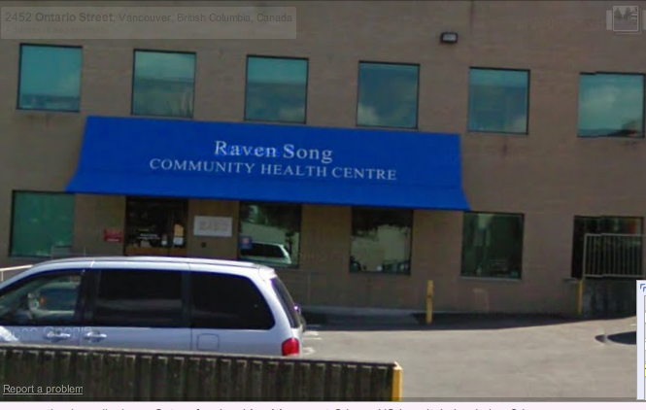

Slide 9
QUESTIONS?

Slide 10
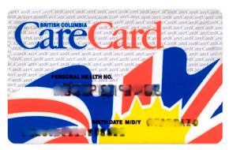
MSP – Medical Services Plan
You must enroll with MSP
MSP insures medically required services
Social services covers you for the first 30 days you’re out of prison – must be covered after
BUT if you have urgent medical needs, Dr will see you no matter what (coverage or not)
Notes:
MSP = health insurance for BC residents
MSP insures medically required services provided by Drs, other health professionals, labs, diagnostics
Pharmacare covers most prescription medications
Type in “MSP BC” on google to find out how to sign up – you should go through the application process before you leave prison
* Cost: ~$50 a month, but if you make less than a certain amount, the monthly fee is waived.

Slide 11
EFFECTIVE JANUARY 1, 2013
EFFECTIVE JANUARY 1, 2013
Adjusted Net Income | One Person | Family of Two | Family of Three or More
$0 - $22,000 | $0.00 | $0.00 | $0.00
$22,001 - $24,000 | $12.80 | $23.20 | $25.60
$24,001 - $26,000 | $25.60 | $46.40 | $51.20
$26,001 - $28,000 | $38.40 | $69.60 | $76.80
$28,001 - $30,000 | $51.20 | $92.80 | $102.40
Over $30,000 | $66.50 | $120.50 | $133.00
Notes:
Vesna posted updated rate – Nov. 18, 2012; only got slightly more expensive for the >$30,000 category
Monthly subsidy rate.
Subsidy means that you
Helpful to have an example? (Alvin) i.e. Joe made $25,000 last year and has a family of three, how much will he have to pay MSP per month?

Slide 12
Pharmacare
Covers most prescription drugs for people – Income based assistance
Need to have MSP to register
At time of purchase, you only pay amount not covered by pharmacare
Notes:
*Offer the phone number for pharmacare, not everyone has access to a computer.
*Pharmacare
Vancouver: 604-683-7151
Outside of Vancouver: 1-800-663-7100
**Government pays 70% until 2% of net income and then pays the rest.
Fair Pharmacare is an income-based plan: calculates you and your spouse’s income based on last year’s tax returns:
http://www.health.gov.bc.ca/pharmacare/

Slide 13
Topics Today
Finding a Doctor
Making an Appointment and Preparing for it
Your Rights As a Patient
Getting the Most out of Your Dr Appointment
Common Symptoms
When to go to Emergency Room
How to Read a Prescription Bottle

Slide 14
QUESTIONS?

Slide 15
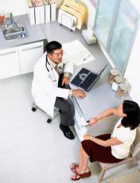
Your Rights as a Patient
To have a friend or someone else with you during an appointment
To be treated with dignity and respect
To not feel judged or discriminated against
To ask questions about your health
To receive good explanations that you
can understand
To disagree with your health care
provider
Notes:
This is from another slide that was removed – reiterating the point of ones rights
Listen to you and treat you with respect
Touch you in a professional manner during a physical exam
Explain what they are doing
Not make assumptions or judgments about your life
Keep what you tell them confidential

Slide 16
Your Rights as a Patient
To get a second opinion
To say no to treatment
To have access to your medical records and read them
To change doctors (but be aware of limited resources)
To have your confidentiality and privacy respected
Notes:
Get a second opinion – ONCE OUTSIDE OF PRISON
Confidentiality in prison – officers outside are “listening without listening”
* Note the medical record will not be available instantly, it will be a process.

Slide 17
Your Responsibilities as a Patient
Show your doctor and health care team respect.
Do not threaten the doctor or nurses.
Do not ask for medication you don’t need.
Share all of the important information with your doctor.
Understand the time limits of the appointment.
Take responsibility for your own health.
Try to live a healthy life.
Notes:
Don’t be abusive
The doctor can choose not to keep you as a patient if your behaviour is inappropriate
*Be nice to the medical office assistant! Smile.
*Patience if there is a long line!

Slide 18
QUESTIONS?

Slide 19
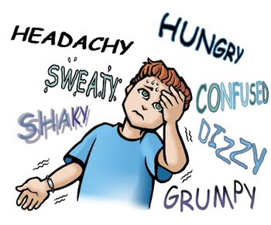
Preparing for your Doctor’s Appointment
What are my Symptoms?
Notes:
What is wrong with my body today?
Think about what/where the problem is?
* How are you feeling?

Slide 20
Where are my Symptoms?
Notes:
Put this on handout
*Point to where the problems are with your finger.

Slide 21
Symptom Details
Typical Questions
When did it start?
Where is the symptom (be precise)?
Has it gotten better or worse?
What do you want to ask your doctor?
Write details down during the meeting

Slide 22
Anxiety
Notes:
These are all good reasons to visit the doctor
I am sure you have experienced at least one of these symptoms at some point
Examples
In the head box – anxiety, this is a treatable medical problem that you don’t have to live with
Chest - Pounding heart, tightness – Many things can cause this, it can be a serious problem or can be normal, be aware when it happens and see if it gets better, worse or stays the same
Difficulty hearing – could be a build up of ear wax, the doctor can fix it
Groin – itching or burning, weird smell, lumps or bumps – all these things can be signs of STDs, the longer the wait to go to the doctor, the worse it can get
Stomach – Diarrhea – Lots of different types of diarrhea, some are very serious
ex. bloody diarrhea, or a few days of non-stop diarrhea – reasons to go to emergency room
Go see your family dr if you have diarrhea every day for a few weeks
Other – night sweats, severe unexplained weight loss

Slide 23
Chest Pain
Notes:
These are all good/common reasons to visit the doctor
I am sure you have experienced at least one of these symptoms at some point
Examples
In the head box – anxiety, this is a treatable medical problem that you don’t have to live with
Chest - Pounding heart, tightness – Many things can cause this, it can be a serious problem or can be normal, be aware when it happens and see if it gets better, worse or stays the same
Difficulty hearing – could be a build up of ear wax, the doctor can fix it
Groin – itching or burning, weird smell, lumps or bumps – all these things can be signs of STDs, the longer the wait to go to the doctor, the worse it can get
Stomach – Diarrhea – Lots of different types of diarrhea, some are very serious
ex. bloody diarrhea, or a few days of non-stop diarrhea – reasons to go to emergency room
Go see your family dr if you have diarrhea every day for a few weeks
Other – night sweats, severe unexplained weight loss

Slide 24
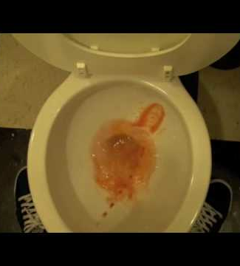
Groin
Notes:
These are all good/common reasons to visit the doctor
I am sure you have experienced at least one of these symptoms at some point
Examples
In the head box – anxiety, this is a treatable medical problem that you don’t have to live with
Chest - Pounding heart, tightness – Many things can cause this, it can be a serious problem or can be normal, be aware when it happens and see if it gets better, worse or stays the same
Difficulty hearing – could be a build up of ear wax, the doctor can fix it
Groin – itching or burning, weird smell, lumps or bumps – all these things can be signs of STDs, the longer the wait to go to the doctor, the worse it can get
Stomach – Diarrhea – Lots of different types of diarrhea, some are very serious
ex. bloody diarrhea, or a few days of non-stop diarrhea – reasons to go to emergency room
Go see your family dr if you have diarrhea every day for a few weeks
Other – night sweats, severe unexplained weight loss

Slide 25
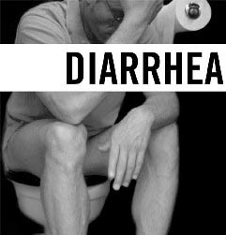
Notes:
These are all good reasons to visit the doctor
I am sure you have experienced at least one of these symptoms at some point
Examples
In the head box – anxiety, this is a treatable medical problem that you don’t have to live with
Chest - Pounding heart, tightness – Many things can cause this, it can be a serious problem or can be normal, be aware when it happens and see if it gets better, worse or stays the same
Difficulty hearing – could be a build up of ear wax, the doctor can fix it
Groin – itching or burning, weird smell, lumps or bumps – all these things can be signs of STDs, the longer the wait to go to the doctor, the worse it can get
Stomach – Diarrhea – Lots of different types of diarrhea, some are very serious
ex. bloody diarrhea, or a few days of non-stop diarrhea – reasons to go to emergency room
Go see your family dr if you have diarrhea every day for a few weeks
Other – night sweats, severe unexplained weight loss

Slide 26
Other Things to Think About

Slide 27
QUESTIONS?

Slide 28
Scheduling Appointments vs. Same Day
What are some examples of when you should make an appointment rather than just showing up?

Slide 29
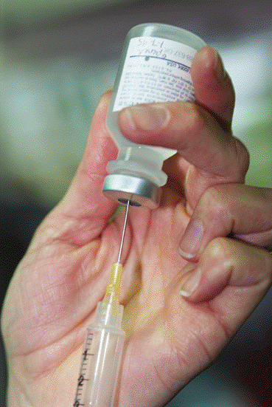
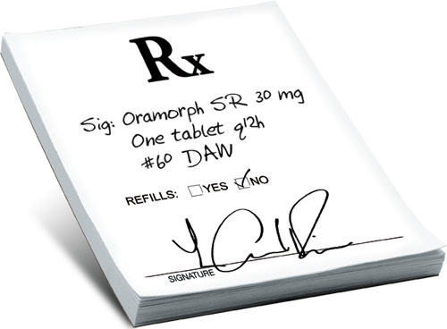
Scheduling Appointments vs. Same Day
Making Appointments (examples)
Vaccinations
Medication Refills
Physical Exams (yearly)
Muscle/Joint Pain (non severe)
Depression
Unexplained changes (appetite, weight change, urine change, severe tiredness)
Allows the Dr. to prepare for you!

Slide 30
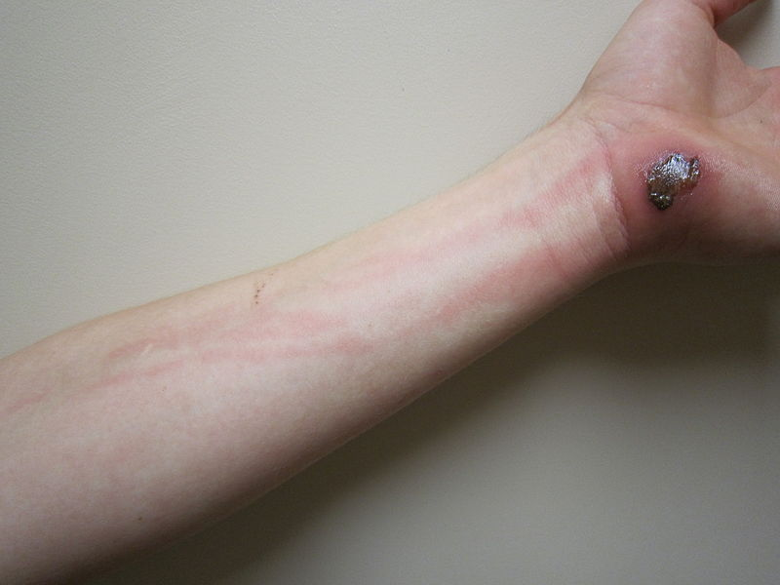
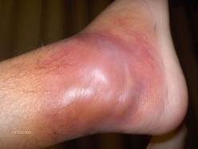
See a Doctor Right Away If:
Call Family Doctor first, or Drop In Clinic or head to Emergency Room if…
Bleeding you can’t stop
Bad infection
Broken Bone
Chest Pain
Severe Diarrhea
Pain you can’t handle
Sudden difficulty breathing
Notes:
This foot has an infection called cellulitis – red color, tight skin, hot skin. This needs to be treated with antibiotics.
*Describe what a bad infection looks like.

Slide 31
QUESTIONS?
Notes:
Ex

Slide 32
Your Relationship With Your Doctor
Your conversation with your doctor is unlike other conversations because:
You discuss sensitive and private issues.
Your time is limited.
Your doctor is an expert on health and disease while you are the expert on your experience of the problem.
You make important decisions that affect your life.
Notes:
Here are some talking points:
Keep in mind that the doctor may not know you well.
Your doctor may ask you questions that seem to have obvious answers, but be patient and answer carefully.
Discuss your ideas and concerns, even if you feel awkward about them.
Work through disagreements.
Ask for a brief summary of your appointment.

Slide 33
Checklist Before You Leave
Included in handout are a list of helpful questions to double check before you leave your visit
Notes:
Ask the Dr to write instructions down for you!
*Consider making this two slides. A lot of information in this slide.
*Talk about the antibiotics.

Slide 34
QUESTIONS?

Slide 35
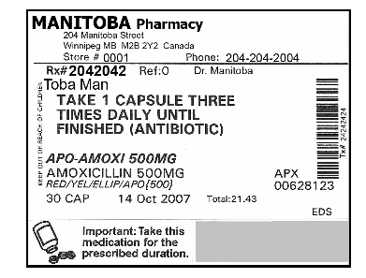
How to Read a Prescription Pill Bottle
Notes:
What you Need to Look at:
Your Name
Directions
What your Taking
Pay Attention to Special Labels
ASK YOUR PHARMACIST ANY QUESTIONS YOU HAVE
*The date is a prescription date.
*Might need the Rx# if you are want a refill, or bring the bottle, or even phone from home!
*Good time to talk more about antibiotics.
*Try to make this a bit more interactive:
“what is the importance of having the pharmacy’s phone number?”
*Can talk about with or without food if not specified, but always good to double check with the pharmacist.

Slide 36
QUESTIONS?

Slide 37
QUIZ
You are allowed to bring a friend/ partner to a doctor’s appointment
True
2. You should always go to the emergency room for diarrhea
False – Sometimes!
3. Once you have a family doctor, you are not allowed to change doctors
False

Slide 38
Thank You!

Slide 39
Notes:
(Give this slide on a handout)
These are all good reasons to visit the doctor
I am sure you have experienced at least one of these symptoms at some point
Examples
In the head box – anxiety, this is a treatable medical problem that you don’t have to live with
Chest - Pounding heart, tightness – Many things can cause this, it can be a serious problem or can be normal, be aware when it happens and see if it gets better, worse or stays the same
Difficulty hearing – could be a build up of ear wax, the doctor can fix it
Groin – itching or burning, weird smell, lumps or bumps – all these things can be signs of STDs, the longer the wait to go to the doctor, the worse it can get
Stomach – Diarrhea – Lots of different types of diarrhea, some are very serious
ex. bloody diarrhea, or a few days of non-stop diarrhea – reasons to go to emergency room
Go see your family dr if you have diarrhea every day for a few weeks
Other – night sweats, severe unexplained weight loss
*Show this at the end and on a handout, WAY too much information!

